Slide 1
Predicting Default Of Credit Card Clients
Abiola Ijaola
DATA606 Capstone
UMBC
Deliverable 2

Slide 2
Literature Review
Introduction
Findings
Data mining techniques
Financial system
Crisis management
Credit risk

Slide 3
Literature Review (cont’d)
Author | Machine Learning Model | Number of Features | Number of Rows | Data period
I-Cheng Yeh, and Che-hui Lien (2007) | K-nearest neighbor classifier (KNN), Logistic Regression (LR), Discriminant Analysis (DA),Naïve Bayesian Classifier (NB), Artificial Neural Networks (ANN), Classification Trees (CT) | 23 | 5529 | 1987-2005
Several studies were researched but of all, this is the most relevant to what I’m working on.

Slide 4
There are two major findings from the literature Review
Probability of likelihood of default for its customers, as well as identify the key drivers that determine this likelihood.
Probability of default payments among mining methods.

Slide 5
Key Takeaway
This paper examines the six major classification techniques in data mining and compares the performance of classification and predictive accuracy among them.

Slide 6
Exploratory Data Analysis
Recap of the project proposal
Pre-Processing / Exploratory Data Analysis steps

Slide 7
Dataset & EDA Steps
Dataset
The dataset is collected from Department of Information Management, Chung Hua University, Taiwan and Department of Civil Engineering, Tamkang University, Taiwan.
The source URLs for the data is
https://archive.ics.uci.edu/ml/datasets/default+of+credit+card+clients.
EDA Steps
Deal with Missing Values if any
Define data types for each column
Understand the dataset
Review Correlation among variables

Slide 8

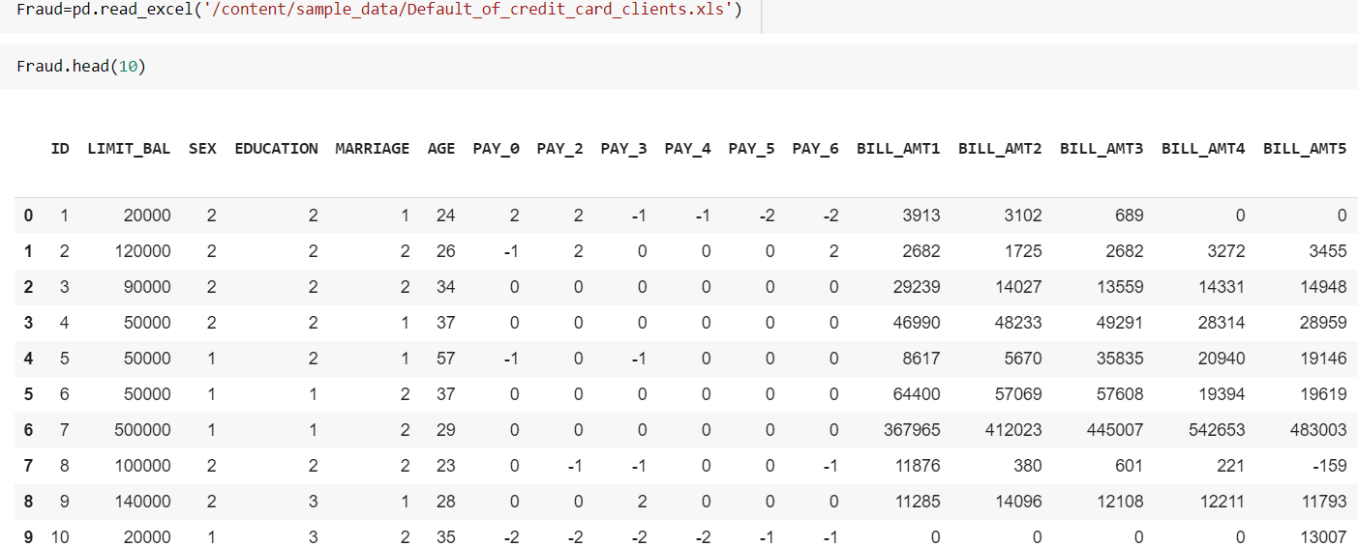
Preliminary Exploratory Data Analysis

Slide 9
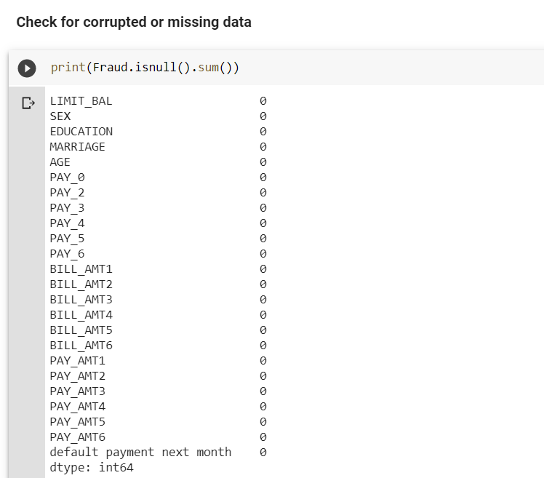
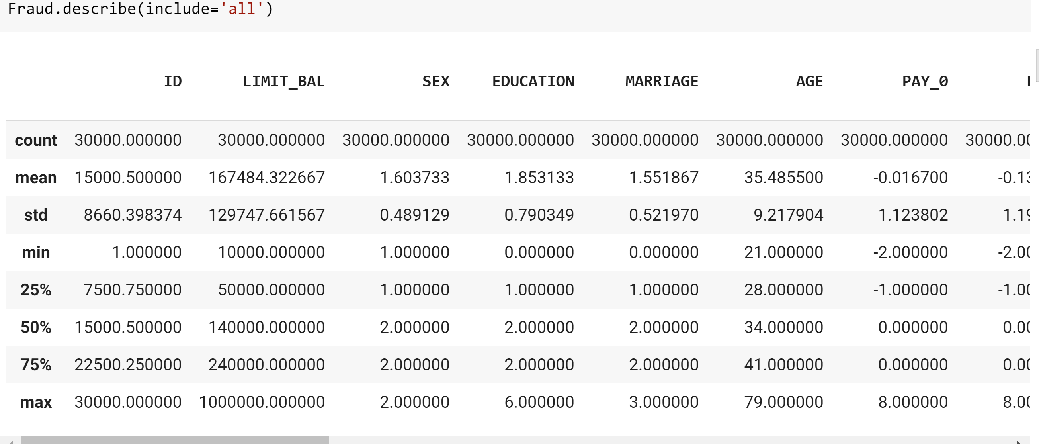

Slide 10
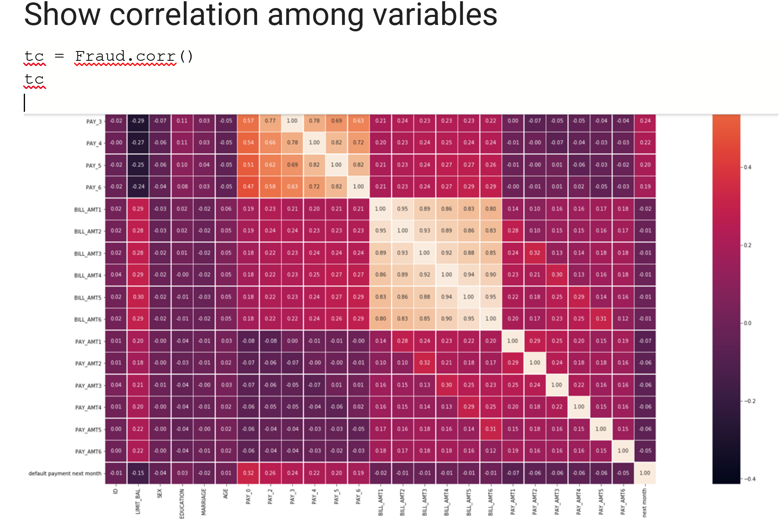

Slide 11

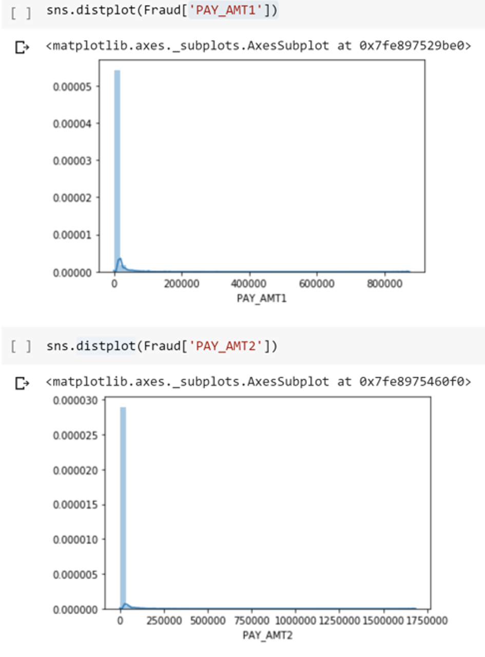
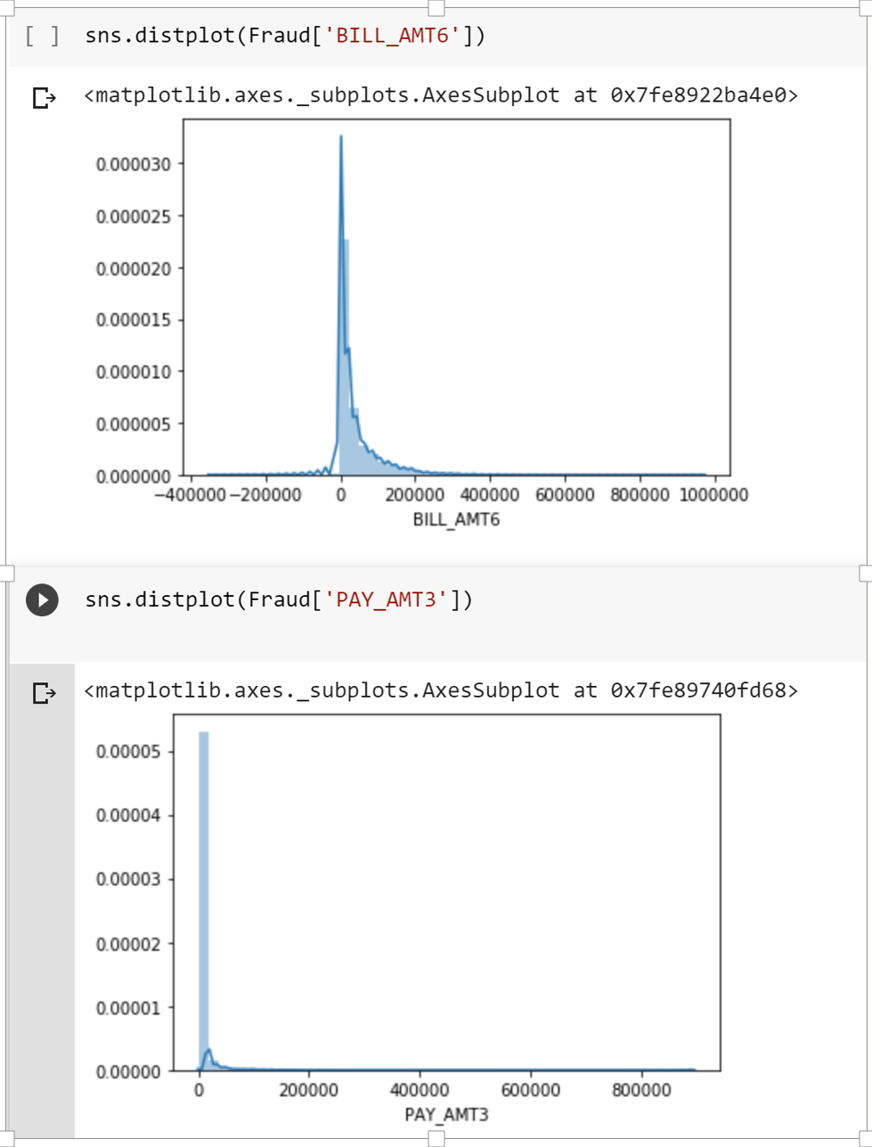

Slide 12
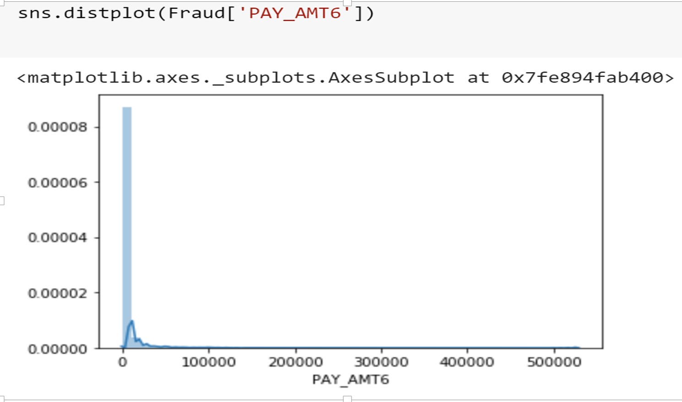

Slide 13
Next Steps
Show the distribution of quantitative data using Box-and-whisker plots, and distribution plots.
Determine if there are clusters based on the features

Slide 14
References
Beaver, W.H (1966). “Financial Ratios as a Prediction of Failure” Journal of Accounting Research, Vol. 4 (Supplement).
Ohlson, J.A. (1980). “Financial Ratios and the Probabilistic Prediction of Bankruptcy”. Journal of Accounting Research. Vol. 19.
Tam, K.Y., and Kiang, M.Y. (1992). “Managerial Applications of Neural Networks: The Case of Bank Failure Predictions” Management Science, Vol 38, 1992
Yu, Q., Miche, Y., Séverin, E., and Lendasse, A. (2014). Bankruptcy prediction using Extreme Learning Machine and financial expertise, Neurocomputing, Volume 128, 2014, Pages 296-302, ISSN 0925-2312, https://doi.org/10.1016/j.neucom.2013.01.063.
Zięba, M., Tomczak, S., Tomczak, J. (2016). Ensemble Boosted Trees with Synthetic Features Generation in Application to Bankruptcy Prediction, Expert Systems with Applications, Volume 58 https://doi.org/10.1016/j.eswa.2016.04.001

Slide 15

Thank you
Notes:
That’s about it for now. I’ll be posting more videos as the project continues. Thank you for listening.

